Slide 1
Similarity and Dissimilarity
More important – used in clustering, some classification, anomaly detection.
Similarity
  Numerical measure of how alike two data objects are.
  Is higher when objects are more alike.
  Often falls in the range [0,1]
Dissimilarity
  Numerical measure of how different are two data objects
  Lower when objects are more alike
  Minimum dissimilarity is often 0
  Upper limit varies
Proximity refers to a similarity or dissimilarity

Slide 2
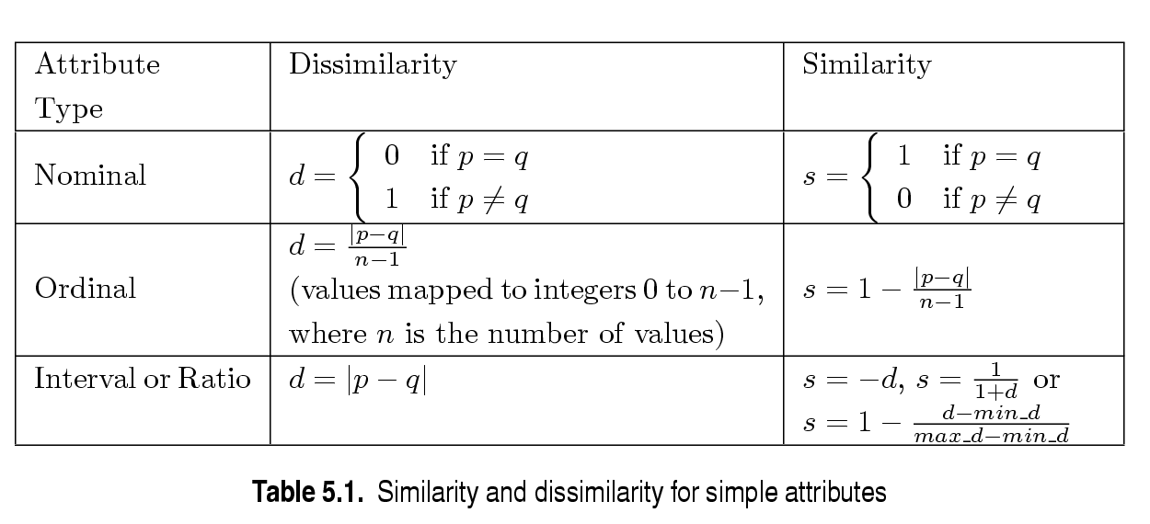
Similarity/Dissimilarity for Objects with Single Attribute
p and q are the attribute values for two data objects.

Slide 3
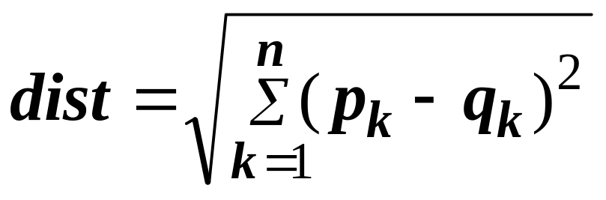
Dissimilarities between Data Objects with multiple Numeric attributes
Euclidean Distance
  Where n is the number of dimensions and p_{k} and q_{k} are, respectively, the k^{th} attributes of data objects p and q.
Standardization is necessary, if scales differ.

Slide 4
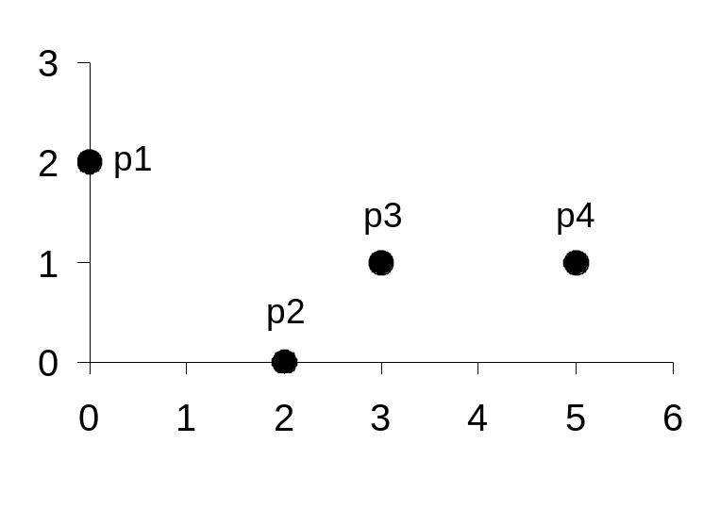
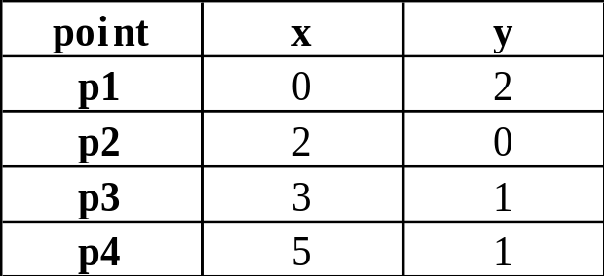
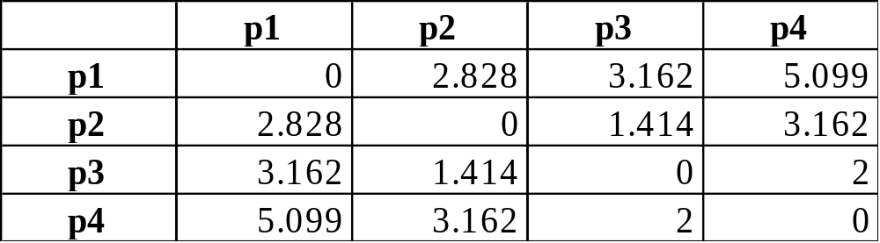
Euclidean Distance
Distance Matrix

Slide 5
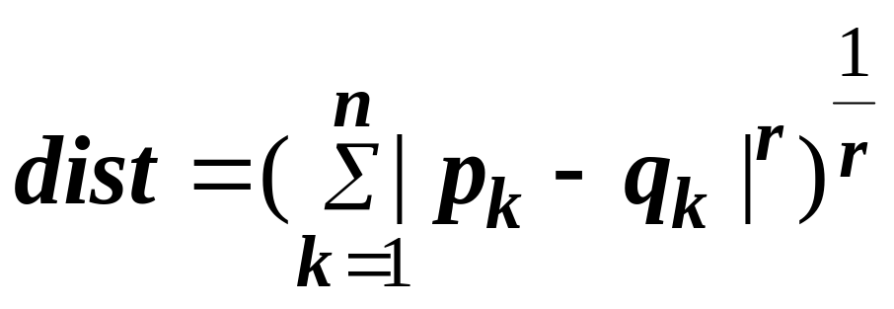
Minkowski Distance
Minkowski Distance is a generalization of Euclidean Distance. Given two objects p and q
  Where r is a parameter, n is the number of dimensions and p_{k} and q_{k} are, respectively, the kth attributes of data objects p and q.

Slide 6
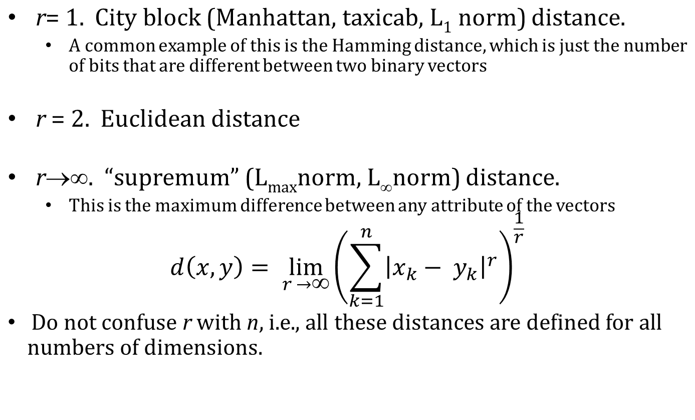
Minkowski Distance: Examples

Slide 7
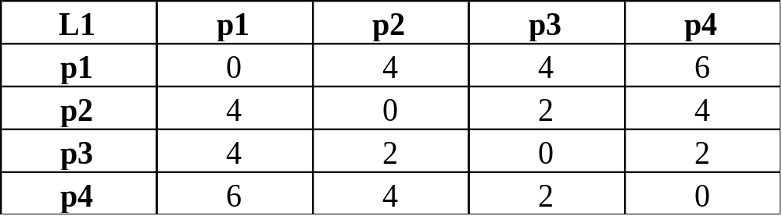
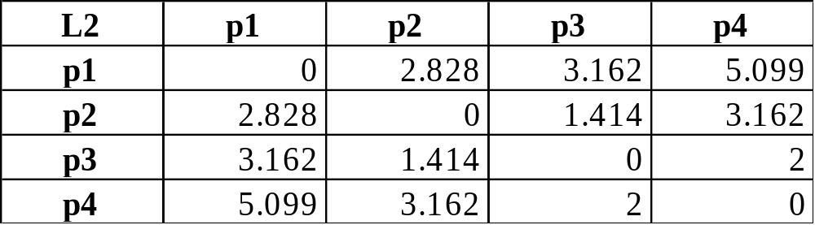
Minkowski Distance
Distance Matrix

Slide 8
Common Properties of a Distance
Distances, such as the Euclidean distance, have some well known properties.
  d(p, q) ≥ 0 for all p and q and d(p, q) = 0 only if
  p = q. (Positive definiteness)
  d(p, q) = d(q, p) for all p and q. (Symmetry)
  d(p, r) ≤ d(p, q) + d(q, r) for all points p, q, and r.
  (Triangle Inequality)
where d(p, q) is the distance (dissimilarity) between points (data objects), p and q.
A distance that satisfies all these properties is a metric

Slide 9
Common Properties of a Similarity
Similarities, also have some well known properties.
  s(p, q) = 1 (or maximum similarity) only if p = q.
  s(p, q) = s(q, p) for all p and q. (Symmetry)
where s(p, q) is the similarity between points (data objects), p and q.

Slide 10
Similarity Between Binary Vectors
Common situation is that objects, p and q, have only binary attributes
Compute similarities using the following quantities
M₀₁ = the number of attributes where p was 0 and q was 1
M₁₀ = the number of attributes where p was 1 and q was 0
M₀₀ = the number of attributes where p was 0 and q was 0
M₁₁ = the number of attributes where p was 1 and q was 1
Simple Matching and Jaccard Coefficients
SMC = number of matches / number of attributes
= (M₁₁ + M₀₀) / (M₀₁ + M₁₀ + M₁₁ + M₀₀)
J = number of 11 matches / number of not-both-zero attributes values
= (M₁₁) / (M₀₁ + M₁₀ + M₁₁)

Slide 11
SMC versus Jaccard: Example
p = 1 0 0 0 0 0 0 0 0 0
q = 0 0 0 0 0 0 1 0 0 1
M₀₁ = 2 (the number of attributes where p was 0 and q was 1)
M₁₀ = 1 (the number of attributes where p was 1 and q was 0)
M₀₀ = 7 (the number of attributes where p was 0 and q was 0)
M₁₁ = 0 (the number of attributes where p was 1 and q was 1)
SMC = (M₁₁ + M₀₀)/(M₀₁ + M₁₀ + M₁₁ + M₀₀) = (0+7) / (2+1+0+7) = 0.7
J = (M₁₁) / (M₀₁ + M₁₀ + M₁₁) = 0 / (2 + 1 + 0) = 0

Slide 12
SMC & JC
SMC - Counts both presences and absences equally. Used for objects with symmetric binary attributes.
Can be used to find students who answered similarly in a test – true/false questions
JC is used to handle objects with assymetric binary attributes.
Ex: In a TDB:
No. of products not purchased is far more than purchased
SMC would say all transactions are very similar.
Use JC

Slide 13
Cosine Similarity
If d₁ and d₂ are two document vectors, then
cos( d₁, d₂ ) = (d₁ • d₂) / ||d₁|| ||d₂|| ,
where • indicates vector dot product and || d || is the length of vector d.
Example:
d₁ = 3 2 0 5 0 0 0 2 0 0
d₂ = 1 0 0 0 0 0 0 1 0 2
d₁ • d₂= 3*1 + 2*0 + 0*0 + 5*0 + 0*0 + 0*0 + 0*0 + 2*1 + 0*0 + 0*2 = 5
||d₁|| = (3*3+2*2+0*0+5*5+0*0+0*0+0*0+2*2+0*0+0*0)^{0.5} = (42) ^{0.5} = 6.481
||d₂|| = (1*1+0*0+0*0+0*0+0*0+0*0+0*0+1*1+0*0+2*2) ^{0.5} = (6) ^{0.5} = 2.245
cos( d₁, d₂ ) = .3150
Cos(x,y) = 0 indicates both are dissimilar
Cos(x,y) = 1 indicates both are similar

Slide 14
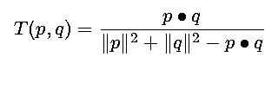
Extended Jaccard Coefficient (Tanimoto)
Variation of JC
Used for document data
Reduces to Jaccard for binary attributes

Slide 15
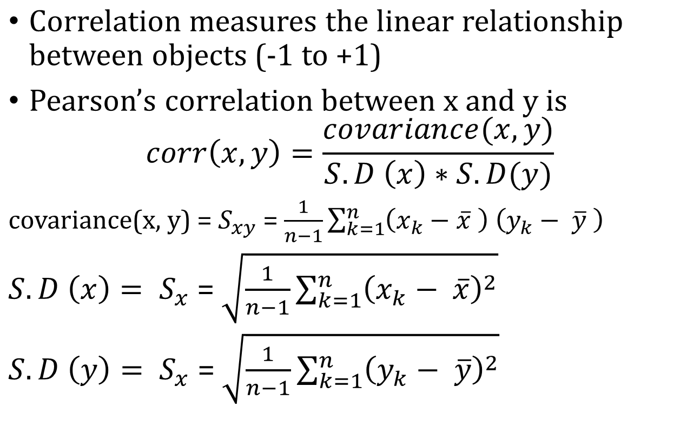
Correlation

Slide 16
Pearson’s Correlation
If correlation between two variables x and y is -1, they are negatively correlated.
  If one increases, the other decreases and vice versa.
If correlation between two variables x and y is +1, they are positively correlated.
  Either both increase or both decrease.
CSE-307-Data Mining

Slide 17
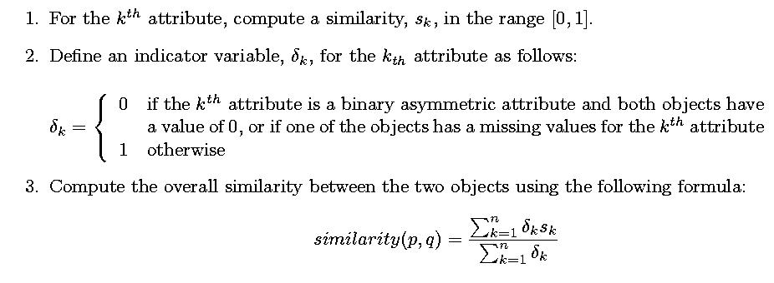
General Approach for Combining Similarities
Sometimes attributes are of many different types, but an overall similarity is needed.

Slide 18

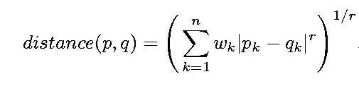
Using Weights to Combine Similarities
May not want to treat all attributes the same.
  Use weights w_{k} which are between 0 and 1 and sum to 1.

